Slide 1
Practical lesson № 9
SIMPLE PHYSIOTHERAPEUTIC PROCEDURES IN THE ORGANIZATION OF CARING PATIENTS

Slide 2
Physiotherapy is a branch of medicine that studies the effect on the human body natural or artificially received physical factors and using them for the purpose of saving, recovery and promotion of health
Local Application of heat and cold to the body can be therapeutic, but before using these therapies, the nurse must understand normal body responses to application of heat and cold and how and when to use.

Slide 3
HOT APPLICATION
Hot application is the application of a hot agent, warmer than skin either in a moist or dry from on the surface of the body.

Slide 4
PHYSIOLOGICAL EFFECTS
HOT APPLICATION
Peripheral Vasodilatation
Increased capillary permeability
Increased oxygen consumption
Increased local metabolism
Decreased blood viscosity
Decreased muscle tone
Increased blood flow
Increased lymph flow
COLD APPLICATION
Peripheral Vasoconstriction
Decreased capillary permeability
Decreased oxygen consumption
Decreased local metabolism
Increased blood viscosity
Increased muscle tone
Decreased blood flow
Decreased lymph flow

Slide 5
Classification of Hot Applications
HOT APPLICATIONS
LOCAL: |  | GENERAL:
Dry heat: | Moist heat | Dry heat: | Moist heat
Hot water bottles Chemical heating bottles Dry Compresses Infrared rays Ultraviolet rays Short wave diathermy Heating lamps Electric cradles Electric heating pads | Hot Compresses Warm soaks (Local baths) Poultices (cataplasm) Stupes (medical fomentations) Paraffin baths Sitz bath Aquathermia pad | Local bath Sun bath Electric cradles Blanket bed | General bath Steam baths Hot packs Whirlpool bath (Full immersion bath)

Slide 6
List the indications for therapeutic uses of hot applications
Spastic pain (in the stomach, gallbladder, intestines);
Spasm muscle tone;
Hypothermia (Provide warmth);
Accelerates regeneration processes (by increasing blood flow);
Inflammatory process before the formation of pus (Resolving action).

Slide 7
List the Contraindications for hot applications
Malignancies
Impaired kidney, heart & lung functions
Acutely purulent Inflammatory process
Open wounds
On clients with paralysis
Edema associated with venous or lymphatic diseases
Headache
Very young & very old client
Client with very high temperature

Slide 8
List the Complications of the hot applications
Burns
Maceration (with moist heat)
Redness of the skin
Edema
Hyperthermia

Slide 9
COLD APPLICATION
Cold application is the application of a cold agent cooler than skin either in a moist or dry form, on the surface of the skin;

Slide 10
Classification of cold Applications
COLD APPLICATIONS
LOCAL: |  | GENERAL:
Dry cold: | Moist cold: | Dry cold: | Moist cold:
Ice pack Chemical cold packs | Cold compress Ice to suck Evaporating lotion | Local bath | General Cold bath Cold sponging Cold wrapping

Slide 11
PHYSIOLOGICAL EFFECTS
HOT APPLICATION
Peripheral Vasodilatation
Increased capillary permeability
Increased oxygen consumption
Increased local metabolism
Decreased blood viscosity
Decreased muscle tone
Increased blood flow
Increased lymph flow
COLD APPLICATION
Peripheral Vasoconstriction
Decreased capillary permeability
Decreased oxygen consumption
Decreased local metabolism
Increased blood viscosity
Increased muscle tone
Decreased blood flow
Decreased lymph flow

Slide 12
List the Indications for therapeutic uses of hot applications
Acute injury (the first day)
Relieves pain (anaesthetize an area) (in the injury area)
Reduce edema (in the injury area)
Reduce inflammation (in the injury area)
Control hemorrhage
Reduces the body temperature
Control the growth of bacteria («acute abdomen»)

Slide 13
List the Contraindications for cold applications
Cold allergy/hypersensitivity
Uncovered open wounds
Compromised circulation
Cardiac disorder
Anesthetic skin
Advanced diabetes

Slide 14
COMPLICATIONS OF COLD APPLICATIONS
Pain
Blisters and skin breakdown
Maceration (with moist cold)
Grey or bluish discoloration
Thrombus formation
Hypothermia

Slide 15
FACTORS AFFECTING HEAT AND COLD TOLERANCE
Body part: Certain areas of the skin have a sensitivity to temperature variations. The inner aspect of the wrist and forearm, the neck, and the perineal area are temperature-sensitive, while the back of the hand and the foot are not as sensitive.
Duration of application: Therapeutic benefits of heat and cold applications are achieved with short periods of exposure to temperature variations. Tolerance increases as the length of exposure increases.
Area of body exposed: The larger the area exposed to heat and cold, the lower the tolerance to temperature changes.  Damage to body surface area: Injured skin areas are more sensitive than intact areas to temperature variations.
Individual tolerance: Tolerance to temperature variations is affected by age and physical condition. The young and the aged are especially susceptible to heat and cold. Neurosensory impairments may interfere with the reception and perception of stimuli, increasing the risk of injury.
Age: Thinner skin layers in children and elderly people increase the risk for burns from the heat and cold applications.
Scientific principles involved in hot and cold applications: Water is a good conductor of heat. Air is a poor conductor of heat. The flow of heat is from the hotter are to the less hot area. Prolonged exposure to moisture increases the skin’s susceptibility to maceration and skin breakdown, reducing the protection of the intact skin. Moisture left on the skin causes rapid cooling due to evaporation of the moisture  Presence of steam increases the temperature of the hot application. Oil acts as insulator and delays the transmission of heat. Woolen absorb moisture slowly, but hold moisture longer and cool off less quickly than the cotton materials.

Slide 16
PRACTICAL SKILLS:
Hot water bottle
Hot water bottle
Ice pack

Slide 17
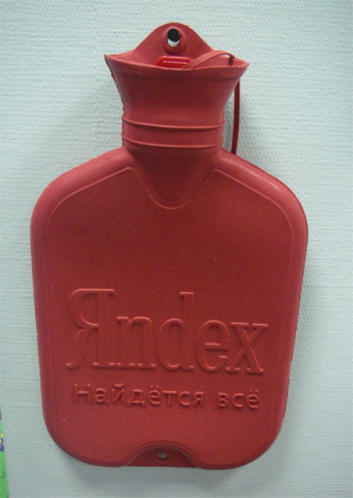
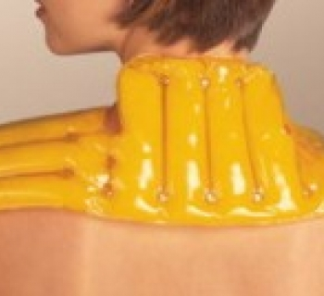
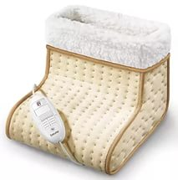
Hot water bottles (Dry heat)
A hot water bottle is a container for local effects of dry heat on any part of the body.
Types of medical hot water bottle:
Rubber (water);
Electrical;
Chemical.

Slide 18
Hot water bottle
Equipment: hot water bottle, water 60-70 º С, thermometer for measuring water temperature, napkins.
The algorithm of actions:
Explain to the patient the purpose and procedure course. Obtain patient's consent.
Give to patient the comfortable position.
Wash hands. Wear gloves. Prepare equipment.
Fill the hot-water bottle with hot water on 3/4.
Remove the air with compression of the top third of a hot-water bottle, close stopper.
Turn over the hot-water bottle, check the tightness. Drain a hot water bottle.
Wrap the hot-water bottle in napkin, put it on the necessary area of a body, then cover the patient. Keep 20 minutes.
In 5 minutes check there is an overheating of tissue (If there is sensitive skin problems).
In 20 minutes remove the hot-water bottle, to examine the skin integuments. Cover the patient and provide rest.
Take off the gloves and put them in the container for waste class Б.
Wash hands hygienic way.
Make a record of results in a medical documentation.

Slide 19
Moist hot compress
Equipment: 6-8 layered gauze napkin, waxed paper, bandages, scissors, solution for cloth wetting (indoor temperature water, 40% pure alcohol or 6% vinegar solution).
Algorithm of actions:
1. Explain the purpose and procedure course. Obtain patient’s consent.
2. Wash hands. Wear gloves. Prepare equipment.
3. Examine the skin of the patient at the place of compress appliance.
4. Moisten the gauze napkin with one of the solutions and well squeeze, put 6-8 layered gauze napkin on the skin.
5. Cover the napkin with a piece of waxed paper (oilcloth) that is 1.5-2 cm more than the previous layer.
6. Cover with a cotton wool layer that is 1.5-2 cm more than the previous layer.
7. Fix the compress with a bandage so that it is densely adjusted to the skin but doesn’t hamper.
8. Record the time of compress application.
9. Wash the hands sanitarily.
10. In 1-2 hours by pushing a finger under the compress make sure that the napkin is damp, and the skin is warm (if the napkin is dry the compress is applied incorrectly).
11. Keep the compress for 6 - 8 hours then remove it, wipe the skin with warm water, dry with the napkin.
12. Wash the hands the sanitarily.
13. Make a record of what you have done.
Remember!
The compress is imposed correctly if the gauze adjacent to skin, after removal of a compress remains warm and damp.

Slide 20
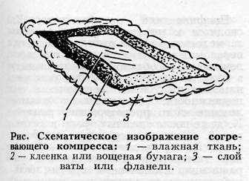
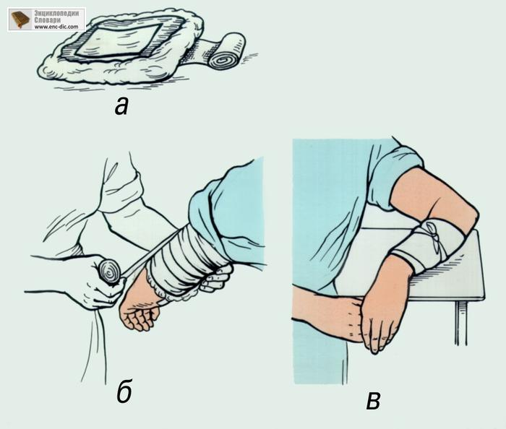

Slide 21
Ice pack
Equipment: ice pieces, ice pack, sheet of fabric, cold water, wtch, thermometer to measure the water temperature.
Algorithm of actions:
1. Explain the purpose and procedure course. Obtain patient’s consent.
2. Wash hands. Wear gloves. Prepare equipment.
3. Fill half of the pack with small pieces of ice, pour them with cold water.
4. Put the ice pack on a horizontal surface, close with lid.
5. Wrap the ice pack in 4 layered sheet of fabric and place it on the necessary site of the body: head area – 5 minutes (with 5 minute interval); peritoneum area – 15-30 minutes (with 30-60 minute interval).
6. Remove the ice pack. Cover the patient and provide a rest.
7. Wash the hands sanitarily.
8. Make a record of what you have done.
Remember!
• if there is a sharp pain because of the ice pack pressure it is hung over the sore area;
• in case of the repeated use of the ice packs, it is obligatory to use newly prepared ice pack;
• when using pack with frozen (in a freezer) water frostbite of a body part can occur.

Slide 22
